Slide 1

COMPUTER ORGANISATION (TỔ CHỨC MÁY TÍNH)
Logic gates and circuits

Slide 2
Acknowledgement
The contents of these slides have origin from School of Computing, National University of Singapore.
We greatly appreciate support from Mr. Aaron Tan Tuck Choy for kindly sharing these materials.

Slide 3
Policies for students
These contents are only used for students PERSONALLY.
Students are NOT allowed to modify or deliver these contents to anywhere or anyone for any purpose.

Slide 4
WHERE ARE WE NOW?
Number systems and codes
Boolean algebra
Logic gates and circuits
Simplification
Combinational circuits
Sequential circuits
Performance
Assembly language
The processor: Datapath and control
Pipelining
Memory hierarchy: Cache
Input/output
Preparation: 2 weeks
Logic Design: 3 weeks
Computer organisation

Slide 5
LOGIC GATES AND CIRCUITS
Gate Symbols
Inverter/AND/OR/NAND/NOR/XOR/XNOR
Drawing and Analysing Logic Circuits
Universal Gates
SOP and NAND Circuits
POS and NOR Circuits
Programmable Logic Array
Read up DLD for details!

Slide 6
LOGIC GATES
Gate symbols
Symbol set 1
Symbol set 2
(ANSI/IEEE Standard 91-1984)
a
b
a
b
&
AND
a⋅b
a⋅b
a
b
a
b
≥1
OR
a+b
a+b
NOT
a
a'
a
1
a'
a
b
a
b
&
NAND
(a⋅b)'
(a⋅b)'
a
b
a
b
≥1
NOR
(a+b)'
(a+b)'
a
b
a
b
=1
EXCLUSIVE OR
a ⊕ b
a ⊕ b

Slide 7
INVERTER/AND/OR GATES
Inverter (NOT gate)
A | A'
0
1
A
A'
A
A'
AND gate
OR gate
A
B
A
B
A ⋅ B
A+B
A | B | A ⋅ B
0 | 0
0 | 1
1 | 0
1 | 1
A | B | A + B
0 | 0
0 | 1
1 | 0
1 | 1
◈

Slide 8
NAND/NOR GATES
NAND gate
≡
A
B
(A ⋅ B)'
A
B
(A ⋅ B)'
A | B | (A ⋅ B)'
0 | 0
0 | 1
1 | 0
1 | 1
≡
NAND
Negative-OR
NOR gate
A
B
≡
A
B
(A + B)'
(A + B)'
A | B | (A + B)'
0 | 0
0 | 1
1 | 0
1 | 1
≡
NOR
Negative-AND
◈

Slide 9
XOR/XNOR GATES
XOR gate
A | B | A ⊕ B
0 | 0
0 | 1
1 | 0
1 | 1
A
B
A ⊕ B
XNOR gate
A | B | (A ⊕ B)'
0 | 0
0 | 1
1 | 0
1 | 1
A
B
(A ⊕ B)'
XNOR can be represented by 🞊 (Example: A 🞊 B)
◈

Slide 10
LOGIC CIRCUITS (1/2)
Fan-in: the number of inputs of a gate.
Gates may have fan-in more than 2.
Example: a 3-input AND gate
Given a Boolean expression, we may implement it as a logic circuit.
Example: F1 = x⋅y⋅z' (note the use of a 3-input AND gate)
x
y
F1
Every input must be connected in a working circuit.
z
z'

Slide 11
LOGIC CIRCUITS (2/2)
Example: F2 = x + y'⋅z
x
x
F2
F2
y'
y
z
y'⋅z
z
y'⋅z
If complemented literals are available
If complemented literals are not available
Example: F3 = x⋅y' + x'⋅z
x
x.y'
x
x.y'
y'
y
F3
F3
x'
z
x'.z
z
x'.z

Slide 12
ANALYSING LOGIC CIRCUITS
Given a logic circuit, we can analyse it to obtain the logic expression.
Example: Given the logic circuit below, what is the Boolean expression of F4?
A
B
C
F4
F4 = ?
◈

Slide 13

QUICK REVIEW QUESTIONS (1)
DLD page 79 Questions 4-1 to 4-4.

Slide 14
UNIVERSAL GATES
AND/OR/NOT gates are sufficient for building any Boolean function.
We call the set {AND, OR, NOT} a complete set of logic.
However, other gates are also used:
Usefulness (eg: XOR gate for parity bit generation)
Economical
Self-sufficient (eg: NAND/NOR gates)

Slide 15
NAND GATE
{NAND} is a complete set of logic.
Proof: Implement NOT/AND/OR using only NAND gates.
x
x'
(x∙x)' = x' (idempotency)
(x∙y)'
x
x∙y
((x∙y)'∙(x∙y)')' = ((x∙y)')' (idempotency)
= x∙y (involution)
y
x'
x
((x∙x)'∙(y∙y)')' = (x'∙y')' (idempotency)
= (x')'+(y')' (DeMorgan)
= x+y (involution)
x+y
y
y'

Slide 16
NOR GATE
{NOR} is a complete set of logic.
Proof: Implement NOT/AND/OR using only NOR gates.
x
x'
(x+x)' = x' (idempotency)
x'
x
((x+x)'+(y+y)')' = (x'+y')' (idempotency)
= (x')'∙(y')' (DeMorgan)
= x∙y (involution)
x∙y
y
y'
(x+y)'
((x+y)'+(x+y)')' = ((x+y)')' (idempotency)
= x+y (involution)
x
x+y
y

Slide 17
QUICK REVIEW QUESTIONS (2)
DLD page 79 Questions 4-6 to 4-8.

Slide 18
SOP AND NAND CIRCUITS (1/2)
An SOP expression can be easily implemented using
2-level AND-OR circuit
2-level NAND circuit
Example: F = A⋅B + C'⋅D + E
Using 2-level AND-OR circuit
A
B
C
F
D
E

Slide 19
SOP AND NAND CIRCUITS (2/2)
Example: F = A⋅B + C'⋅D + E
Using 2-level NAND circuit
A
A
B
B
C
C
F
F
D
D
E
E
A
B
C
F
D
E

Slide 20
POS AND NOR CIRCUITS (1/2)
A POS expression can be easily implemented using
2-level OR-AND circuit
2-level NOR circuit
Example: G = (A+B) ⋅ (C'+D) ⋅ E
Using 2-level OR-AND circuit
A
B
C
D
G
E

Slide 21
POS AND NOR CIRCUITS (2/2)
Example: G = (A+B) ⋅ (C'+D) ⋅ E
Using 2-level NOR circuit
A
A
B
B
C
C
D
G
D
G
E
E
A
B
C
D
G
E

Slide 22

READING ASSIGNMENT
Propagation Delay
Read up DLD section 4.5, pg 75 – 77.
Integrated Circuit Logic Families
Read up DLD section 4.6, pg 77 – 78.

Slide 23
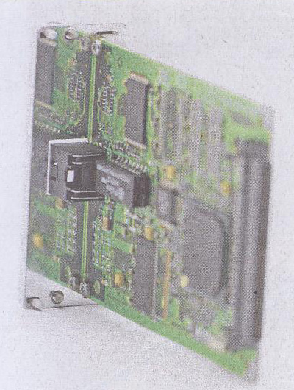

INTEGRATED CIRCUIT (IC) CHIP
Example of a 74LS00 chip: Quad NAND gates.
1
Vcc = 5v
2
3
4
14
13
12
11
10
9
8
5
6
GND
7

Slide 24
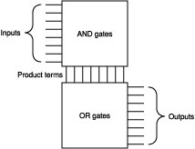
PROGRAMMABLE LOGIC ARRAY
A programmable integrated circuit – implements sum-of-products circuits (allow multiple outputs).
2 stages
AND gates = product terms
OR gates = outputs
Connections between inputs and the planes can be ‘burned’.

Slide 25
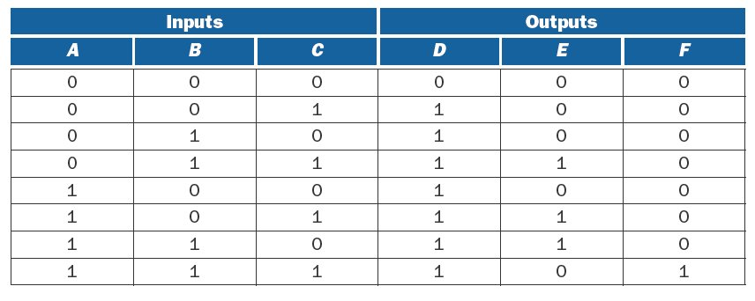
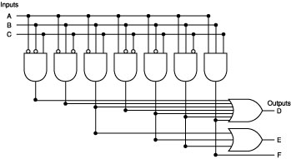
PLA EXAMPLE (1/2)

Slide 26
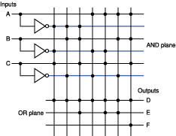
PLA EXAMPLE (2/2)
Simplified representation of previous PLA.

Slide 27
READ ONLY MEMORY (ROM)
Similar to PLA
Set of inputs (called addresses)
Set of outputs
Programmable mapping between inputs and outputs
Fully decoded: able to implement any mapping.
In contrast, PLAs may not be able to implement a given mapping due to not having enough minterms.

Slide 28
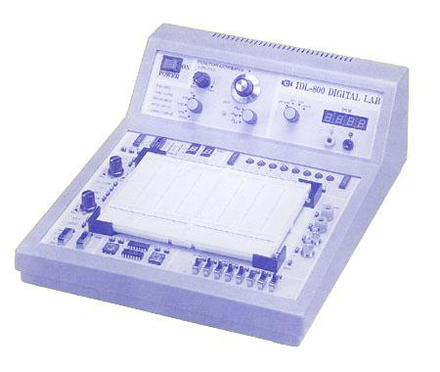
LAB ASSIGNMENTS (1/3)
For the first few labs, you will implement simple circuits using the Logic Trainer

Slide 29

LAB ASSIGNMENTS (2/3)
Lab sheets will be given out in lectures.
Remember to read the Lab Guidelines and Lab #1 Introductory Lab before you come for your first lab session.
For subsequent labs, please read the lab sheet and fill up as much as you can before the lab, or you may not have enough time to complete your lab experiment.
Aim to finish your experiment as quickly as possible. Vacate the room 10 minutes before the hour. If not, just submit your lab report.

Slide 30
LAB ASSIGNMENTS (3/3)
No make-up lab if you miss a lab. If you have valid reason, you will be given an “EX” (exempt) mark and your CA marks will not suffer. You may submit your medical certificate or other relevant document to your labTA.
To attend a different group only for that week with valid reason, please seek consent from the lecturer, preferably at least two days in advance.

Slide 31
Q&A

